Slide 1






BigData
Presentation by
U-DATA
CAPSTONE PROJECT | 2022

Slide 2









Table of Content
1
2
3
4
5
6
7
INTRUDACTION
DATASET
DASHBORED
EDA
PRE-
PROSSISING
PIG
MODLES

Slide 3
INTRODUCTION

Slide 4

Introduction
False indication have a big impact on the decision-making process, if the data was biased towards specific sample, and this sample is not representative, it will lead to bad decision.
For example:
Age should be 15-20/ 21-26
The salary should have more than 4 values for categorical, and it is preferred to be continuous value rather than categorical.

Slide 5
Objective
Our objective is to study a dataset that is not representative and what is the effect of decision makers about the EDA and the dashboard of this data.

Slide 6
General
Questions
Predicting if the employee has greater than 50K salary, or less than 50K, using classification.
Predicting the capital gain for the employees, using regression.

Slide 7
2030 vision
As one of the keys for the Vision which is increase the number of employees in Saudi Arabia, reduce the overall unemployment rate, and ensuring that the data is correct, representative, logical and meaningful, we used this dataset to visualize and understand how the false indication of data can affect the decision making.

Slide 8



PROJECT
OVERVIEW
The data we used is from UCI, the data set also known as "Census Income" dataset.
We came with 2 approaches:
Classification with 4 models, to predict the salary
Regression with 4 models, to predict the capital gain

Slide 9
DATASET

Slide 10




DATASET
OVERVIEW
1M
15
9
6
RECORDS
COLUMNS
CATEGORICAL
NUMERICAL

Slide 11
'capital_gain','capital_loss','hours_per_week','native_country','salary'
DATASET
OVERVIEW
1
2
3
4
5
AGE
WORKCLASS
FNLWGT
EDUCATION
EDUCATION_NUM
6
7
8
9
10
MARITAL_STATUS
OCCUPATION
RELATIONSHIP
RACE
GENDER
11
12
13
14
15
CAPITAL_GAIN
CAPITAL_LOSS
HOURS_PER_WEEK
NATIVE_
COUNTRY
SALARY

Slide 12
DASHBORED

Slide 13
EDA

Slide 14
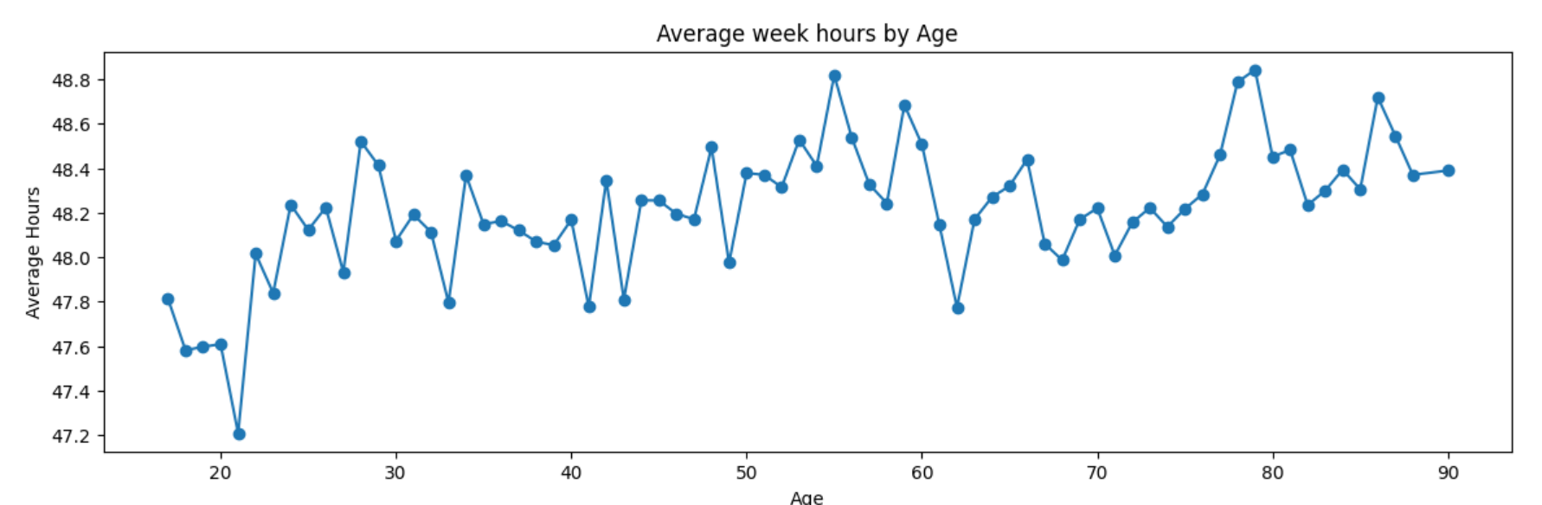
Average week hours by age
LINE PLOT

Slide 15
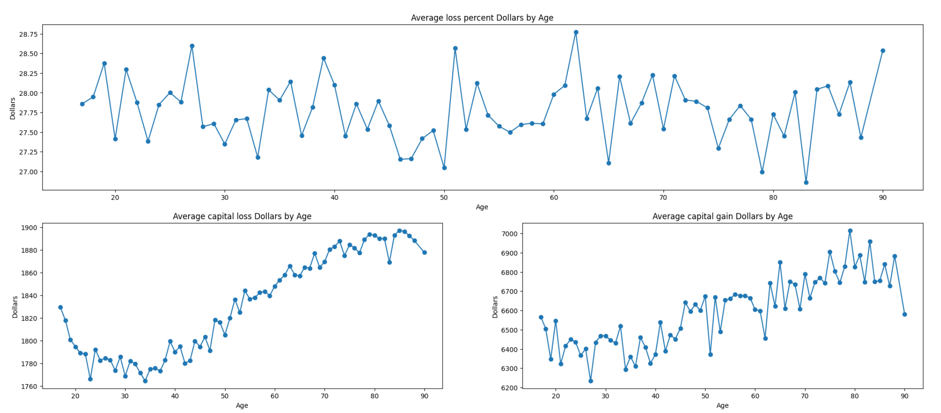
The Average based on age
LINE PLOT

Slide 16
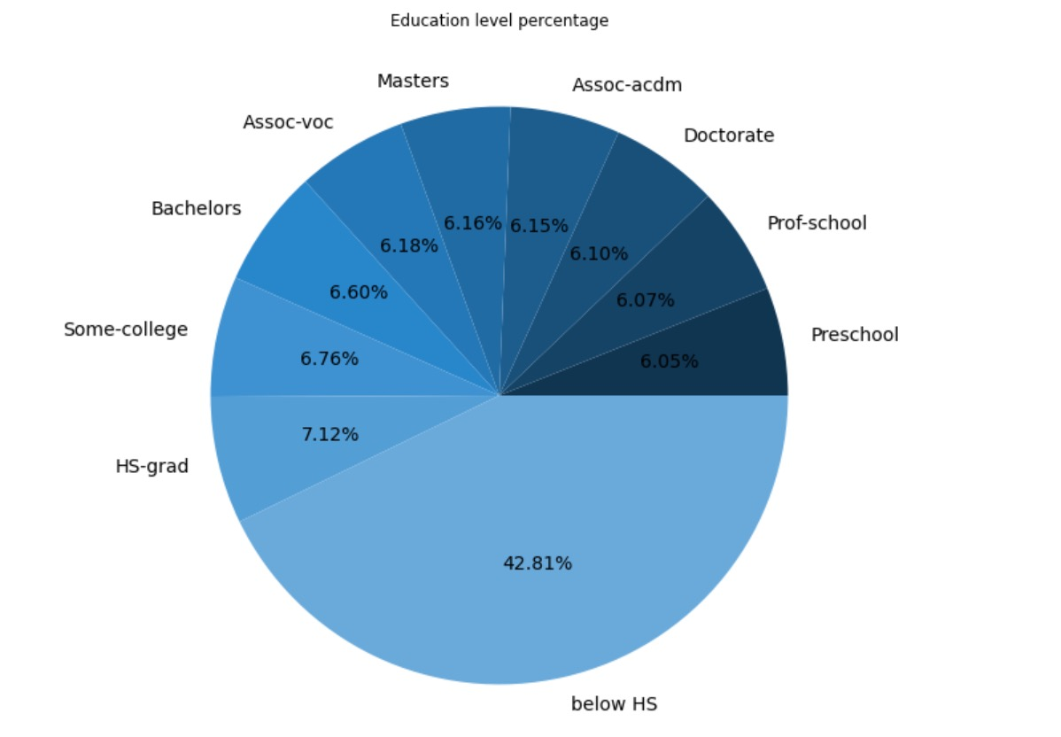

Education level percentage
PIE PLOT

Slide 17
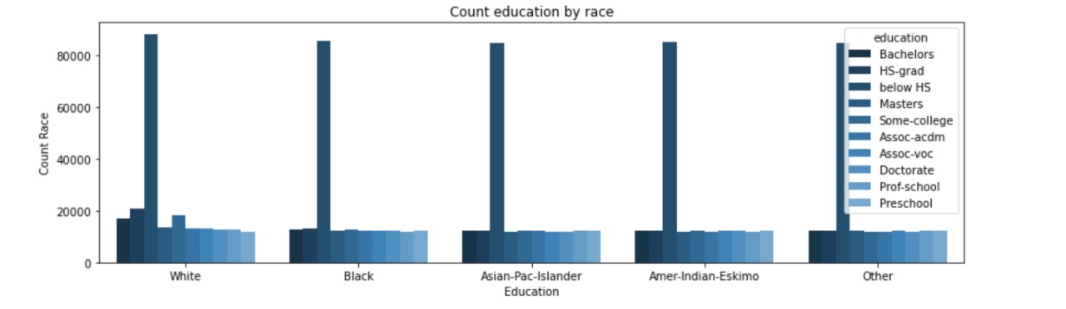
Count education by race
COUNT PLOT

Slide 18
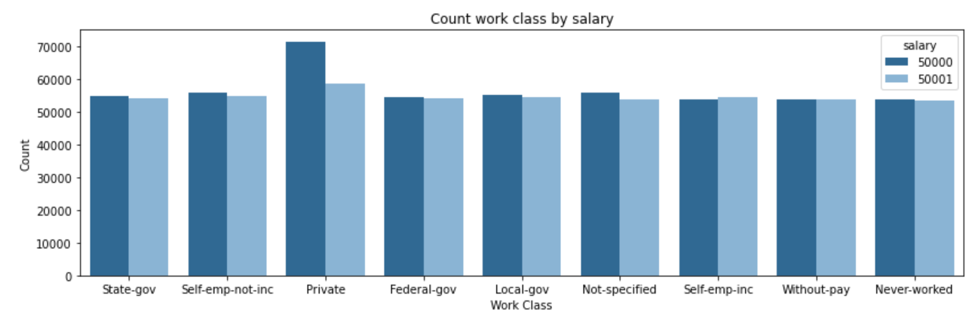
Work class by salary
COUNT PLOT

Slide 19
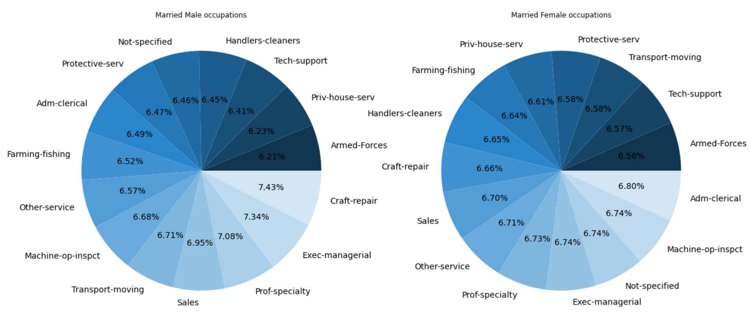
Occupations
PIE PLOT

Slide 20
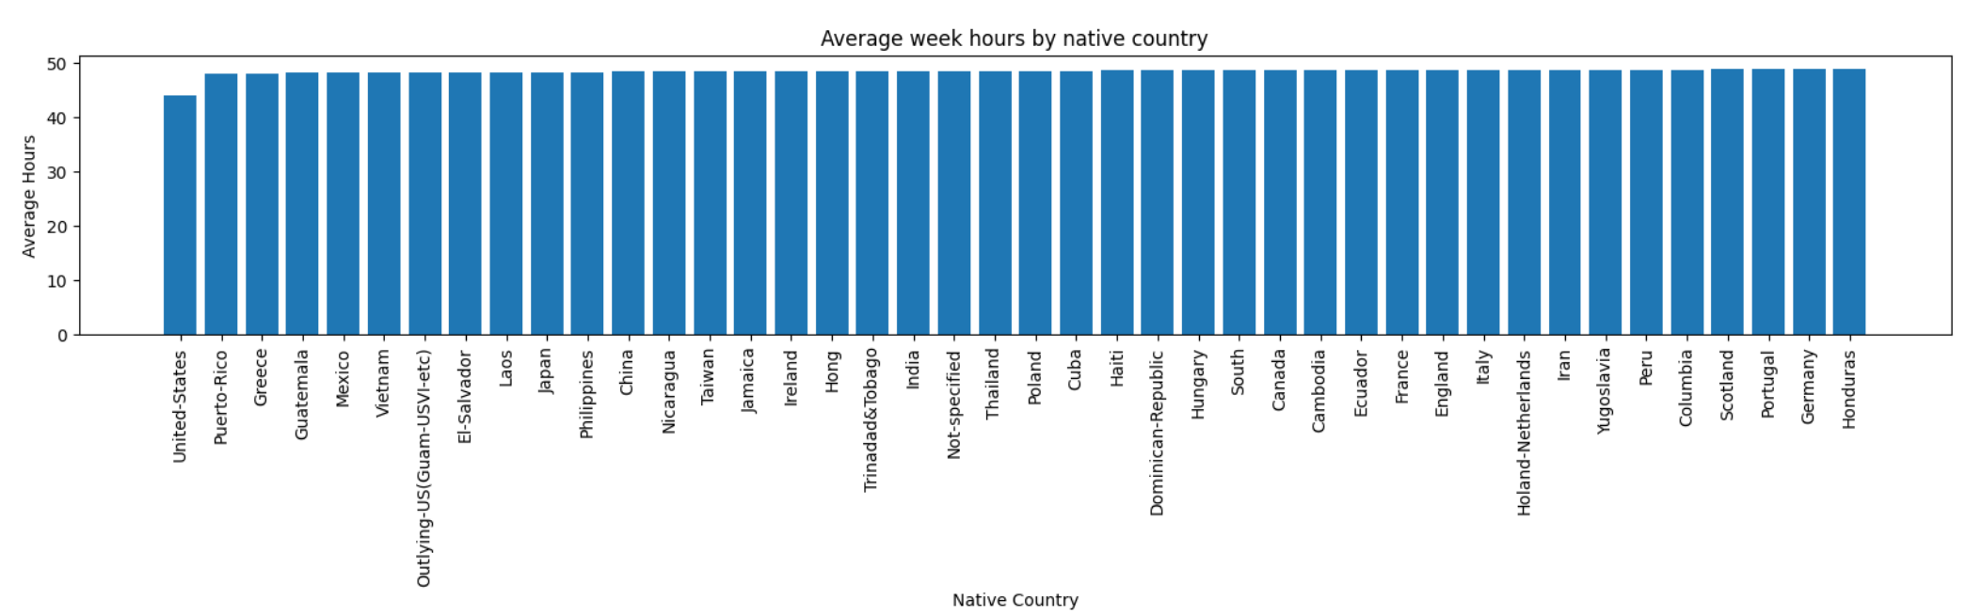
Average week hours by native country
BAR PLOT

Slide 21
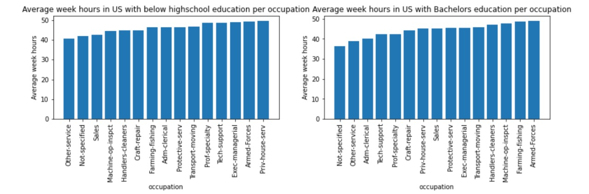
Average week hours in U.S
BAR PLOT

Slide 22
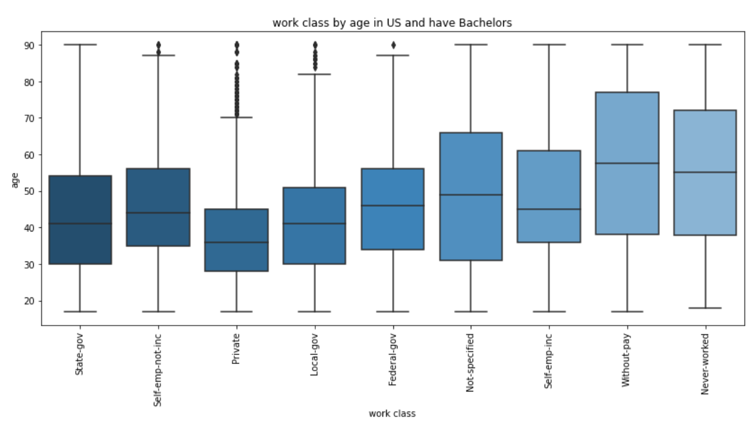
Work class by age
BOX PLOT

Slide 23
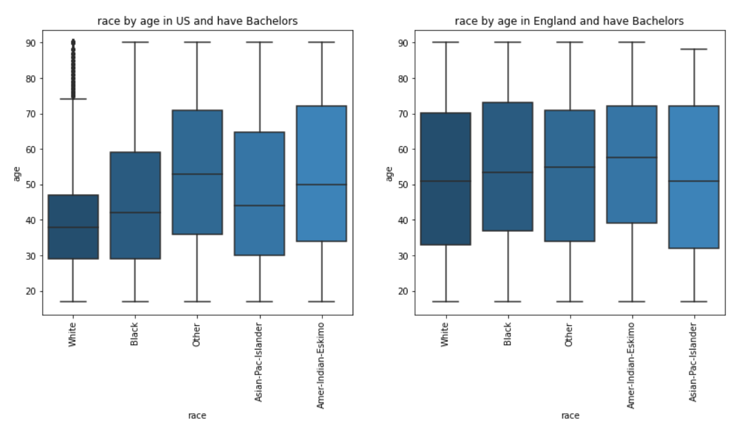
Race by age
BOX PLOT

Slide 24
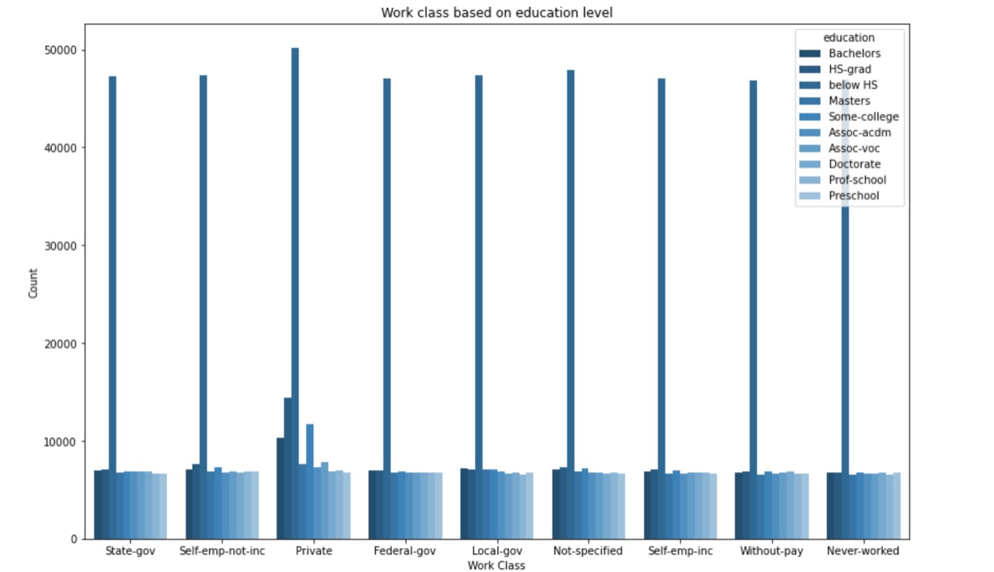
Work class based on education level
COUNT PLOT

Slide 25
PRE-PROSSISING

Slide 26
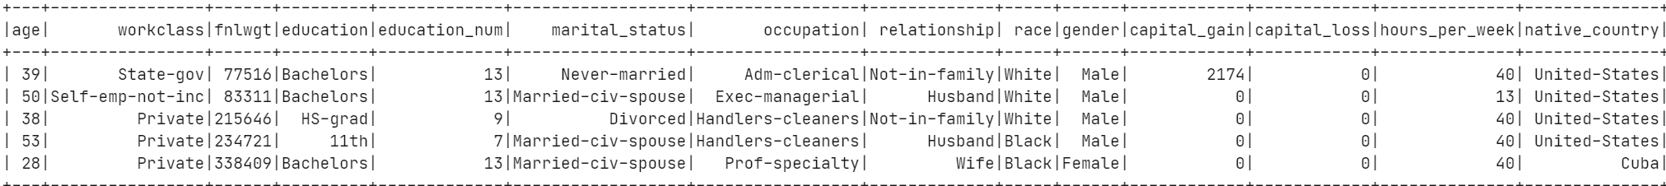
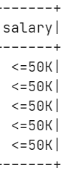
00
DATASET

Slide 27
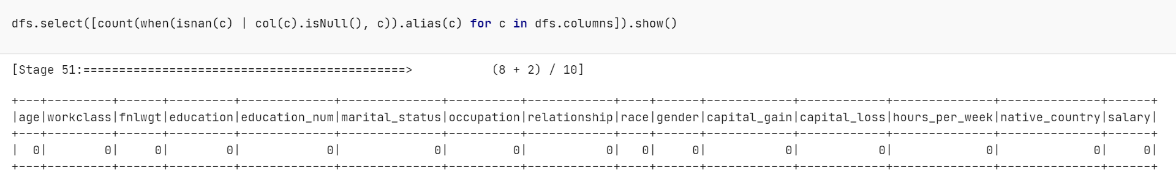
01
Check the null value

Slide 28
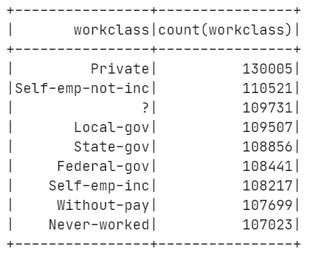
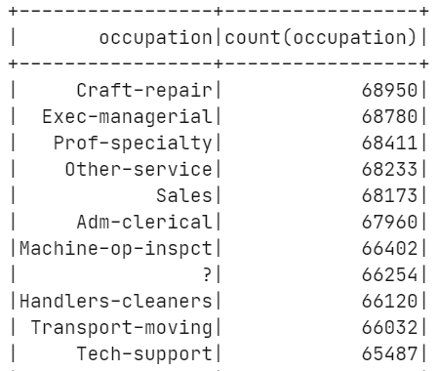
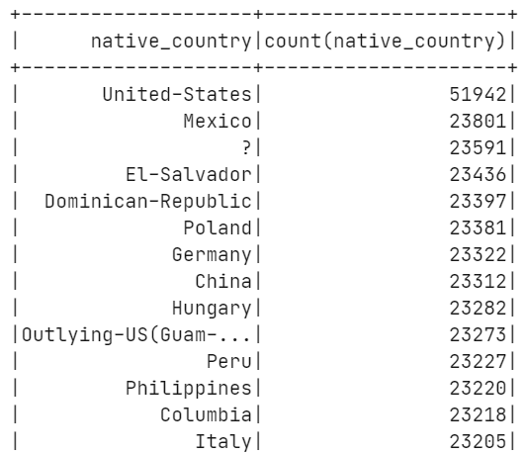
02
Discovering the data

Slide 29
02
Replacing the '?' in all the columns with Not-specified
dfs=dfs.withColumn( 'workclass’ , regexp_replace('workclass’ , "\\?", 'Not-specified’ ))
dfs=dfs.withColumn('occupation', regexp_replace('occupation', "\\?", 'Not-specified’ ))
dfs=dfs.withColumn('native_country’ , regexp_replace('native_country’ , "\\?", 'Not-specified'))

Slide 30
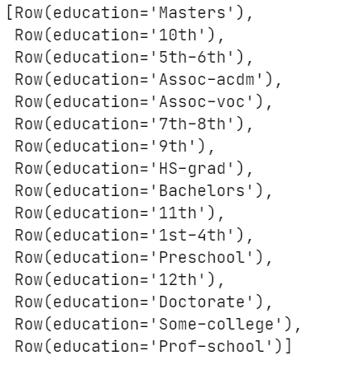
03
Make the education values consistent

Slide 31
03
Make the education values consistent
dfs=dfs.withColumn('education’ , regexp_replace('education', "5th-6th“ , '6th’ ))
dfs=dfs.withColumn('education’ , regexp_replace('education’, “7th-8th“ , ‘8th’ ))
dfs=dfs.withColumn('education’ , regexp_replace('education’, “1st-4th“ , ‘4th’ ))

Slide 32
04
Change the values for salary to be 0 if <=50k, and 1 if >50k
dfs=dfs.withColumn('salary’ , regexp_replace('salary', "<=50K“ , '0’ ))
dfs=dfs.withColumn('salary’ , regexp_replace('salary’, “> 50K“ , ‘1’ ))
dfs = dfs.withColumn( "salary“ , dfs["salary"].cast('int'))

Slide 33
05
Percentage of fnlwgt column
sum_fnlwgt=dfs.select(sum('fnlwgt')).collect()[0][0]
dfs=dfs.withColumn('fnlwgt_percentage’ ,round((dfs.fnlwgt/sum_fnlwgt)*100,2))

Slide 34
06
Profit column
#The difference of capital gain and loss
dfs=dfs.withColumn('diffrence_capital_gain_loos',(dfs.capital_gain-dfs.capital_loss))
dfs=dfs.withColumn('profit',when((dfs.diffrence_capital_gain_loos >0), lit(1)).when((dfs.diffrence_capital_gain_loos ==0), lit(0)).when((dfs.diffrence_capital_gain_loos <0), lit(-1)))

Slide 35
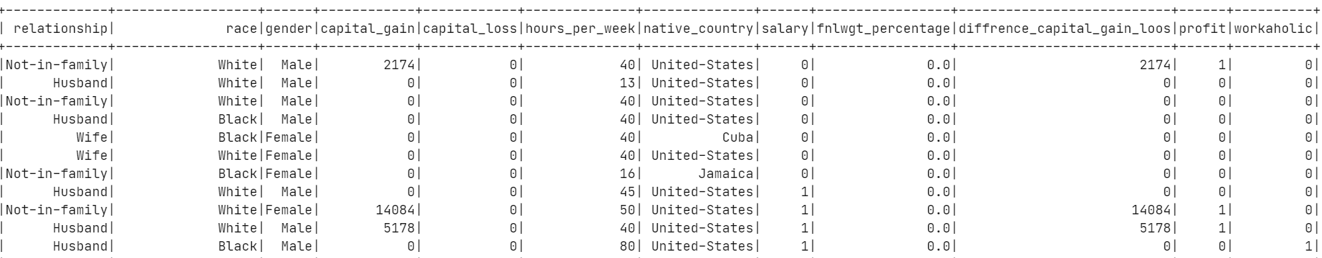
07
Workholic column
dfs=dfs.withColumn('workaholic',when((dfs.hours_per_week >=70), lit(1)).when((dfs.hours_per_week <70), lit(0)))

Slide 36
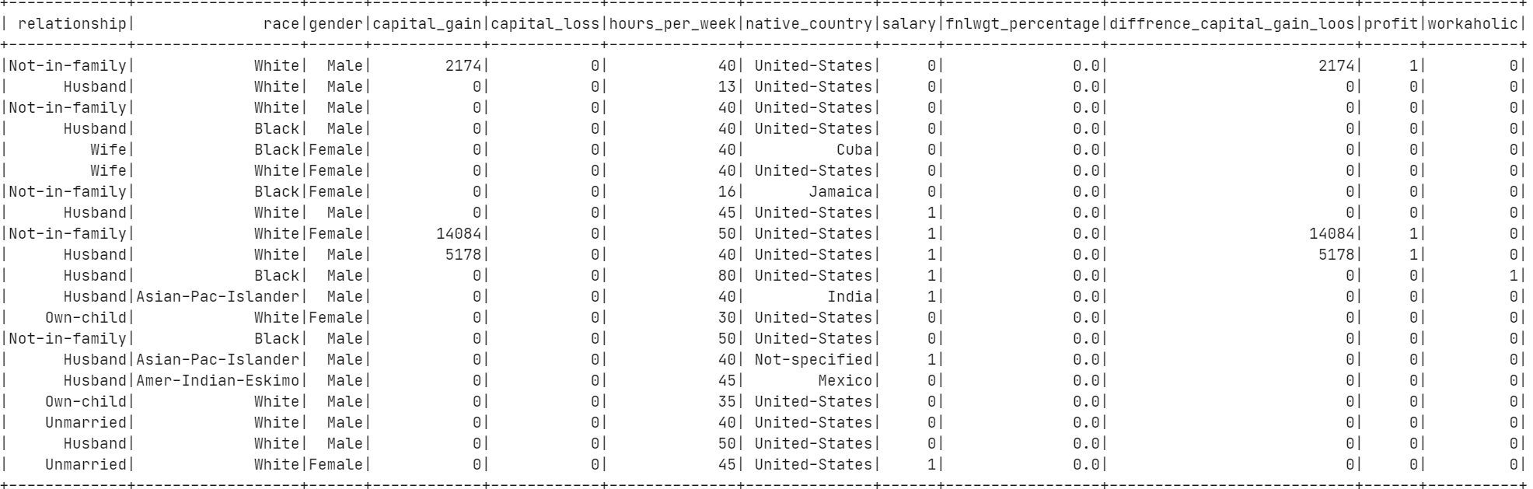
The dataset

Slide 37
PIG

Slide 38
01
How Many Females, and males?
-- Group by gender
group_gender = GROUP adult by gender;
-- Creating a count
count_gender = FOREACH group_gender GENERATE group as gender, COUNT(adult.gender) AS count_num;
-- displaying the results
Dump count_gender;

Slide 39
01
RESULT
(Male,505923)
(Female,494077)

Slide 40
02
How Many salaries >50K and <=50k?
-- Group by the salary
group_salary = GROUP adult by salary;
-- Creating a count
count_salary = FOREACH group_salary GENERATE group as salary, COUNT(adult.salary) AS count_num;
-- displaying the results
Dump count_salary;

Slide 41
02
RESULT
(50000,508522)
(50001,491478)

Slide 42
03
The numbers of instance in each country?
-- Group by native_country
group_native_country = GROUP adult by native_country;
-- Creating a count
count_native_country = FOREACH group_native_country GENERATE group as native_country, COUNT(adult. native_country) AS count_num;
-- displaying the results
Dump count_native_country;

Slide 43
03
RESULT
(Cuba,23186)
(Hong,22882)
(Iran,22964)
(Laos,22788)
(Peru,23227)
(China,23312)
(Haiti,22979)
(India,23193)
(Italy,23205)

Slide 44
04
How many dose have capital gain grater than the capital loss?
-- Filtering by capital gain> capital loss?
filter_gain_grater_loss= FILTER adult BY (capital_gain>capital_loss);
-- Group by the all
group_gain_grater_loss = GROUP filter_gain_grater_loss all;
-- Creating a count
count_gain_grater_loss = FOREACH group_gain_grater_loss GENERATE COUNT(filter_gain_grater_loss) AS count_num;
-- displaying the count number
Dump count_gain_grater_loss;

Slide 45
04
RESULT
(786310)

Slide 46
05
How many races are there?
-- Group by the all
group_race = GROUP adult by race;
-- Creating a count
count_race = FOREACH group_race GENERATE group as race, COUNT(adult.race) AS count_num;
-- displaying the count number
Dump count_race;

Slide 47
05
RESULT
(Black,196853)
(Other,193367)
(White,221239)
(Amer-Indian-Eskimo,194177)
(Asian-Pac-Islander,194364)

Slide 48
06
Highest count of education num, desc order?
-- Group by the all
group_education_num = GROUP adult by education_num;
-- Creating a count
count_education_num = FOREACH group_education_num GENERATE group as education_num, COUNT(adult.education_num) AS count_num;
-- order the result
order_count_education_num = ORDER count_education_num BY count_num DESC;
-- displaying the count number
Dump order_count_education_num;

Slide 49
06
RESULT
(9,70891)
(10,67427)
(13,65664)
(14,62508)
(11,61947)
(12,61728)
(7,61579)
(6,61502)
(15,61366)

Slide 50
07
Count the Work class that education is Masters and salary greater than 50k in desc order?
-- Filtter the data based on the condition in question
Masters_Filter = FILTER adult BY education == 'Masters' and salary =='50001';
-- Group by the workclass
group_workclass = GROUP Masters_Filter by workclass;
-- Creating a count
count_workclass = FOREACH group_workclass GENERATE group as workclass, COUNT(Masters_Filter.workclass) AS count_num;
-- Order the result
order_count_workclass = ORDER count_workclass BY count_num DESC;
-- displaying the results
Dump order_count_workclass;

Slide 51
07
RESULT
(Private,3894)
(Local-gov,3517)
(Self-emp-not-inc,3460)
(Not-specified,3433)
(Federal-gov,3357)
(Self-emp-inc,3356)
(State-gov,3320)
(Without-pay,3316)
(Never-worked,3265)

Slide 52
08
Count Marital status that race is White and capital gain is less than 1000 and salary less than 50k in desc order?
-- Filtter the data based on the condition in question
marital_status_Filter = FILTER adult BY race == 'White' and salary =='50000' and capital_gain < 1000;
-- Group by the marital_status
group_All = GROUP marital_status_Filter By marital_status;
-- Creating a count
count_marital_status = FOREACH group_All GENERATE group as marital_status , COUNT(marital_status_Filter.marital_status) AS count_num;
-- Order the result
order_count_marital_status = ORDER count_marital_status BY count_num DESC;
-- displaying the results
Dump order_count_marital_status;

Slide 53
08
RESULT
(Never-married,8816)
(Married-civ-spouse,7566)
(Divorced,3957)
(Widowed,1396)
(Separated,1331)
(Married-spouse-absent,945)
(Married-AF-spouse,769)

Slide 54
09
Count the number of people who is unmarried and female and in US and have Doctorate or Bachelors or Masters degree ?
-- Filtter the data based on the condition in question
PPL_Filter = FILTER adult BY relationship == 'Unmarried' and gender =='Female’
and native_country =='United-States’ and
(education == 'Masters' OR education == 'Bachelors' OR education == 'Doctorate');
-- Group by the ALL
group_All = GROUP PPL_Filter ALL;
-- Creating a count
count_PPL = FOREACH group_All GENERATE COUNT(PPL_Filter) AS count_num;
-- displaying the results
Dump count_PPL;

Slide 55
09
RESULT
(670)

Slide 56
10
Find the minimum and maximum capital gain which is black race and occupation is Tech-support or Sales?
-- Filtter the data based on the condition in question
occupation_Filter = FILTER adult BY race == 'Black' and (occupation == 'Tech-support' or occupation == 'Sales');
-- Group by all
groupByAll = GROUP occupation_Filter all;
-- minimum and maximum capital gain
min_max_capital_gain = FOREACH groupByAll GENERATE MIN(occupation_Filter.capital_gain) AS Min_capital_gain, MAX(occupation_Filter.capital_gain) AS Max_capital_gain;
-- displaying the results
Dump min_max_capital_gain;

Slide 57
10
RESULT
(0,99999)

Slide 58
11
Find the minimum and maximum hours_per_week which is Private workclass and marital_status is Never-married or Divorced?
-- Filtter the data based on the condition in question
Private_Filter = FILTER adult BY workclass == 'Private' and (marital_status == 'Never-married' or marital_status == 'Divorced');
-- Group by all
groupByAll = GROUP Private_Filter all;
-- minimum and maximum capital gain
min_max_hours = FOREACH groupByAll GENERATE MIN(Private_Filter.hours_per_week) AS Min_hours, MAX(Private_Filter.hours_per_week) AS Max_hours;
-- displaying the results
Dump min_max_hours;

Slide 59
11
RESULT
(1,99)

Slide 60
12
Count workaholic who works more than or equal 70 hours and their age between 20 and 40?
-- Filtter the data based on the condition in question
workaholic_Filter = FILTER adult BY hours_per_week >= 70 and age >= 20 and age <= 40;
-- Group by the ALL
group_All = GROUP workaholic_Filter ALL;
-- Creating a count
count_workaholic_Filter = FOREACH group_All GENERATE COUNT(workaholic_Filter) AS count_num;
-- displaying the results
Dump count_workaholic_Filter;

Slide 61
12
RESULT
(77657)

Slide 62
13
Occupation count desc order?
-- Group by the occupation
group_occupation_num = GROUP adult by occupation;
-- Creating a count
count_occupation_num = FOREACH group_occupation_num GENERATE group as occupation, COUNT(adult.occupation) AS count_num;
-- Ordering the result
order_count_occupation_num = ORDER count_occupation_num BY count_num DESC;
-- Displaying the result
Dump order_count_occupation_num;

Slide 63
13
RESULT
(Handlers-cleaners,66120) (Transport-moving,66032) (Tech-support,65487) (Farming-fishing,65323) (Protective-serv,64940) (Priv-house-serv,64523) (Armed-Forces,64412) | (Craft-repair,68950) (Exec-managerial,68780) (Prof-specialty,68411) (Other-service,68233) (Sales,68173) (Adm-clerical,67960) (Machine-op-inspct,66402) (Not-specified,66254)

Slide 64
14
count relationship in desc order?
-- Group by the relationship
group_relationship_num = GROUP adult by relationship;
-- Creating a count
count_relationship_num = FOREACH group_relationship_num GENERATE group as relationship, COUNT(adult.relationship) AS count_num;
-- Ordering the result
order_count_relationship_num = ORDER count_relationship_num BY count_num DESC;
-- Displaying the result
Dump order_count_relationship_num;

Slide 65
14
RESULT
(Husband,173999)
(Not-in-family,170334)
(Own-child,166055)
(Unmarried,164685)
(Wife,162599)
(Other-relative,162328)

Slide 66
15
Count salary >50K and Bachelors?
-- Filtter the data based on the condition in question
bachelors_filter = FILTER adult BY (salary== 50001) and (education=='Bachelors');
-- Group by the ALL
group_All = GROUP bachelors_filter ALL;
-- Creating a count
count_bachelors_filter = FOREACH group_All GENERATE COUNT(bachelors_filter) AS count_num;
-- displaying the results
Dump count_bachelors_filter;

Slide 67
15
RESULT
(32639)

Slide 68
16
Count male and female who have Bachelors?
-- Filtter the data based on the condition in question
bachelors_filter = FILTER adult BY (education=='Bachelors');
-- Group by the by gender
group_gender = GROUP bachelors_filter by gender;
-- Creating a count
count_bachelors_gender_filter = FOREACH group_gender GENERATE group as gender, COUNT(bachelors_filter.gender) AS count_num;
-- displaying the results
Dump count_bachelors_gender_filter;

Slide 69
16
RESULT
(Male,34116)
(Female,31837)

Slide 70
17
Maxumim and Minimum capital gain for female and male?
-- Group by the by gender
group_gender = GROUP adult by gender;
-- Max and Min capital gain
max_min_gender_gain = FOREACH group_gender GENERATE group as gender, MIN(adult.capital_gain) AS min_gain, MAX(adult.capital_gain) AS max_gain;
-- displaying the results
Dump max_min_gender_gain;

Slide 71
17
RESULT
(Male,0,99999)
(Female,0,99999)

Slide 72
18
Count not specified occupation?
-- Filtter the data based on the condition in question
not_specified_filter = FILTER adult BY (occupation =='Not-specified');
-- Group by the by all
group_not_specified = GROUP not_specified_filter all;
-- Creating a count
count_not_specified = FOREACH group_not_specified GENERATE COUNT(not_specified_filter) AS count_num;
-- displaying the results
Dump count_not_specified;

Slide 73
18
RESULT
(66254)

Slide 74
19
Count occupation with >50k for female and male desc order?
-- Filtter the data based on the condition in question
greater_50k_filter = FILTER adult BY (salary== 50001);
-- Group by the gender
group_greater_50k_gender = GROUP greater_50k_filter by gender;
-- Creating a count
count_greater_50k_gender = FOREACH group_greater_50k_gender GENERATE group as gender,COUNT(greater_50k_filter.gender) AS count_num;
-- Ordering the result
order_count_relationship_num = ORDER count_greater_50k_gender BY count_num DESC;
-- displaying the results
Dump count_greater_50k_gender;

Slide 75
19
RESULT
(Male,248601)
(Female,242877)

Slide 76
20
Count workclass and gender
--grouping the data based on workclass and gender
workclass_gender = group adult BY (gender, workclass);
--counting the instances of workclass for each gender
count_workclass_gender = FOREACH workclass_gender GENERATE FLATTEN(group) AS (gender, workclass),
COUNT(adult.age) AS workclass_gender_count;
-- displaying the results
DUMP count_workclass_gender

Slide 77
20
RESULT
Female,Private,61421 Female,Local-gov,54326 Female,State-gov,54479 Female,Federal-gov,54135 Female,Without-pay,53979 Female,Never-worked,53350 Female,Self-emp-inc,53449 Female,Not-specified,54515 Female,Self-emp-not-inc,54423 | Male,Private,68584 Male,Local-gov,55181 Male,State-gov,54377 Male,Federal-gov,54306 Male,Without-pay,53720 Male,Never-worked,53673 Male,Self-emp-inc,54768 Male,Not-specified,55216 Male,Self-emp-not-inc,56098

Slide 78
21
How many people who work more than 50 hours a week earn less than 50k by gender?
-- Filtter the data based on the condition in question
filter_fiftyhours_fiftyk = FILTER adult BY (hours_per_week > 50) AND (salary == '50000');
--grouping the data by salary and gender
group_data = GROUP filter_fiftyhours_fiftyk BY (salary, gender);
--Counting the result
count_fiftyhours_fiftyk = FOREACH group_data GENERATE FLATTEN(group) AS (salary, gender), COUNT(filter_fiftyhours_fiftyk.age) AS count_people;
--displaying the results
DUMP count_fiftyhours_fiftyk;

Slide 79
21
RESULT
(50000,Male,115281)
(50000,Female,113385)

Slide 80
22
How much salary for each ethnicity?
--grouping the data by salary and and race
salary_race = GROUP adult BY (salary, race);
--counting the result
count_salary_race = FOREACH salary_race GENERATE FLATTEN(group) AS (salary, race), COUNT(adult.age) AS race_salary;
--displaying the results
DUMP count_salary_race;

Slide 81
22
RESULT
(50000,Black,99638
50000,Other,97124
50000,White,117544
50000,Amer-Indian-Eskimo,97040
50000,Asian-Pac-Islander,97176
50001,Black,97215
50001,Other,96243
50001,White,103695
50001,Amer-Indian-Eskimo,97137
50001,Asian-Pac-Islander,97188)

Slide 82
23
How much salary for each education level?
--grouping the data by salary and education
education_salary = GROUP adult BY (salary, education);
--counting the results
count_education_salary = FOREACH education_salary GENERATE FLATTEN(group) AS (salary, education), COUNT(adult.age) AS salary_education;
--displaying the results
DUMP count_education_salary;

Slide 83
23
RESULT
50000,Bachelors,33314 50000,Doctorate,30457 50000,Preschool,30157 50000,Assoc-acdm,31151 50000,Prof-school,30254 50000,Some-college,36129 50001,4th,30238 50001,6th,30197 50001,8th,30407 50001,9th,30540 | 50000,4th,30529 50000,6th,30762 50000,8th,30811 50000,9th,30339 50000,10th,31091 50000,11th,31464 50000,12th,30849 50000,HS-grad,39348 50000,Masters,30730 50000,Assoc-voc,31137

Slide 84
24
How much is the average number of years spent on education for each ethnicity?
--grouping the data by and and race
group_race = GROUP adult BY race;
--Counting the results
count_education_race = FOREACH group_race GENERATE FLATTEN(group) AS race, AVG(adult.education_num) AS avg_education;
--Displaying the results
DUMP count_education_race;

Slide 85
24
RESULT
(Black,8.508734944349337)
(Other,8.530695516815175)
(White,8.721617797947017)
(Amer-Indian-Eskimo,8.507660536520802)
(Asian-Pac-Islander,8.517271716984627)

Slide 86
25
How many people are younger than 20 and working ? grouped by their education
-- Filtter the data based on the condition in question
aged_less_20 = FILTER adult BY (age < 20);
--grouping the data by education
group_race = GROUP aged_less_20 BY education;
--counting the result
count_age_less_20 = FOREACH group_race GENERATE FLATTEN(group) AS education, COUNT(aged_less_20.fnlwgt) AS count_less_20;
--displaying the results
DUMP count_age_less_20;

Slide 87
25
RESULT
Assoc-voc,2465 Bachelors,2385 Doctorate,2471 Preschool,2443 Assoc-acdm,2429 Prof-school,2535 Some-college,2943 | 4th,2506 6th,2475 8th,2518 9th,2534 10th,2701 11th,2925 12th,2674 HS-grad,2909 Masters,2455

Slide 88
26
how many people over the age of 60 still working?
-- Filtter the data based on the condition in question
Filter_1 = FILTER adult BY (age > 60);
-- Group the data by the filter that i just created
Filtered_group = Group Filter_1 all;
-- Count the filltered
Count_older_than_60 = FOREACH Filtered_group GENERATE COUNT(Filter_1);
-- displaying the results
DUMP Count_older_than_60;

Slide 89
26
RESULT
(386234)

Slide 90
27
How many people get salary that <=50k per education in percentage?
-- -- Group by education
grp = group adult by education;
-- Bag
result = foreach grp {
total = COUNT(adult);
t = filter adult by salary == '<=50K’;
--Create a bag which contains only T values
generate flatten(group) as education, total as TOTAL_ROWS_IN_INPUT_TABLE, 100*(double)COUNT(t)/(double)total as PERCENTAGE_TRUE_IN_INPUT_TABLE; };
-- displaying the results
DUMP result;

Slide 91
27
RESULT
Masters,61648,49.84752141188684 Assoc-voc,61762,50.414494349276254 Bachelors,65952,50.510977680737504 Doctorate,61039,49.89760644833631 Preschool,60518,49.831455104266496 Assoc-acdm,61486,50.66356568975051 Prof-school,60711,49.832814481724895 Some-college,67606,53.44052303050025 | 4th,60767,50.23943916928596 6th,60959,50.46342623730704 8th,61218,50.32996830997419 9th,60879,49.834918444783916 10th,61443,50.601370375795454 11th,61898,50.83201395844777 12th,60908,50.64851907795364 HS-grad,71205,55.26016431430377

Slide 92
28
Are work hours difference by education (in average)?
-- Group the data by the filter that i just created
Filtered_group = Group adult by education;
-- The Average houres
average_hours_education = FOREACH Filtered_group GENERATE group, AVG(adult.hours_per_week);
-- displaying the results
DUMP average_hours_education;

Slide 93
28
RESULT
Masters,48.39344342071114 Assoc-voc,48.42663773841521 Bachelors,47.98689956331878 Doctorate,48.55679155949475 Preschool,48.38101060841402 Assoc-acdm,48.18779884851836 Prof-school,48.51680914496549 Some-college,47.41446025500695 | 4th,48.50081458686458 6th,48.54228251775784 8th,48.3031951386847 9th,48.23796382989208 10th,48.23890435037352 11th,48.267650004846686 12th,48.532934918237345 HS-grad,47.176715118320345

Slide 94
29
Count race per education?
-- Group the data by the filter that i just created
Filtered_group = Group adult by (race,education);
-- Count the race for per education
Count_race_per_education = FOREACH Filtered_group GENERATE flatten(group) as (race,education), COUNT(adult) as countrace;
-- Displaying the results
DUMP Count_Occupation_per_education;

Slide 95
29
RESULT
Amer-Indian-Eskimo,4th,12176 Amer-Indian-Eskimo,6th,12133 Amer-Indian-Eskimo,8th,12274 Amer-Indian-Eskimo,9th,12036 Asian-Pac-Islander,4th,11989 Asian-Pac-Islander,6th,12050 Asian-Pac-Islander,8th,12283 Asian-Pac-Islander,9th,12165 Asian-Pac-Islander,10th,12049 | White,4th,12205 White,6th,12433 White,8th,12677 White,9th,12361 White,10th,12954 White,11th,13091 White,12th,12497 White,HS-grad,20906 White,Masters,13438 | Other,4th,12116 Other,6th,12172 Other,8th,11912 Other,9th,12200 Other,10th,12052 Other,11th,11998 Other,12th,12143 Other,HS-grad,12223 Other,Masters,12112 | Black,4th,12281 Black,6th,12171 Black,8th,12072 Black,9th,12117 Black,10th,12304 Black,11th,12241 Black,12th,12271 Black,HS-grad,13277 Black,Masters,12133

Slide 96
30
Count Occupation based on education?
-- Group the data by the filter that i just created
Filtered_group = Group adult by (occupation,education);
-- Count Occupation
Count_Occupation_per_education = FOREACH Filtered_group GENERATE flatten(group) as (occupation,education), COUNT(adult) as countrace;
-- Displaying the results
DUMP Count_Occupation_per_education;

Slide 97
30
RESULT
Craft-repair,4th,4114 Craft-repair,6th,4154 Craft-repair,8th,4124 Craft-repair,9th,4130 Craft-repair,10th,4209 Craft-repair,11th,4209 Craft-repair,12th,4118 Craft-repair,HS-grad,6004 Craft-repair,Masters,4106 | Armed-Forces,4th,4002 Armed-Forces,6th,4029 Armed-Forces,8th,4137 Armed-Forces,9th,3985 Armed-Forces,10th,4018 Armed-Forces,11th,4051 Armed-Forces,12th,4016 Armed-Forces,HS-grad,4053 Armed-Forces,Masters,3983 | Adm-clerical,4th,3897 Adm-clerical,6th,3912 Adm-clerical,8th,3935 Adm-clerical,9th,4101 Adm-clerical,10th,4079 Adm-clerical,11th,4086 Adm-clerical,12th,4137 Adm-clerical,HS-grad,5216 Adm-clerical,Masters,4048 | Sales,4th,4189 Sales,6th,4101 Sales,8th,4058 Sales,9th,4074 Sales,10th,4184 Sales,11th,4081 Sales,12th,3945 Sales,HS-grad,5091 Sales,Masters,4098

Slide 98
31
Average age for each workclass?
-- Group the data by the filter that i just created
Filtered_group = Group adult by workclass;
-- Average age in each workclass
Average_age_for_each_workclass = FOREACH Filtered_group GENERATE group, AVG(adult.age);
-- Displaying the resuDUMP Average_age_for_each_workclass;
lts

Slide 99
31
RESULT
Private,50.14677897003961
Local-gov,52.855744381637706
State-gov,52.91764273574939
Federal-gov,52.89754797539676
Without-pay,53.03623989080678
Never-worked,52.991796155966476
Self-emp-inc,52.86593603592781
Not-specified,52.65998669473531
Self-emp-not-inc,52.774

Slide 100
MODELS

Slide 101

MODELS
ACCURECY
Classification
Regression
51%
50%
79%
78%
Decision Tree
Gradient Boosted Trees
Decision Tree
Gradient Boosted Trees

Slide 102

PROJECT
DETAILS
We searched for dataset with 1M record and 15 columns, but the datasets was limited either it is not applicable to use or has been used in the previous weeks.
So, we did extra work instead of the preprocessing, which is:
Two hyper parameter tuning for the best 2 models, and their pipeline in both regression and classification
Using both regression and classification, with 4 models in each
31 Pig Question

Slide 103

THANK YOU!

